Slide 1
Biss Presentation
By Alan B.

Slide 2
Introduction:
In this project I will find an optimal location for a restaurant. Specifically, this report will be targeted to stakeholders interested in opening a Mexican Food in Newcastle, UK.
Since there are lots of restaurants in Newcastle, we will try to detect locations that are not already crowded with restaurants. We are also particularly interested in areas with no Italian restaurants in vicinity. We would also prefer locations as close to city center as possible, assuming that first two conditions are met.

Slide 3
Data:
Based on definition of our problem, factors that will influence our decision are:
number of existing restaurants in the neighborhood (any type of restaurant)
number of and distance to Italian restaurants in the neighborhood, if any
distance of neighborhood from city center
We decided to use regularly spaced grid of locations, centered around city center, to define our neighborhoods.

Slide 4
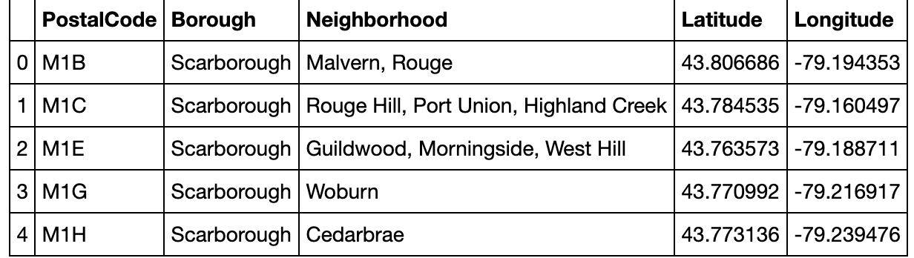
Let's first find the latitude & longitude of Newcastle city center, using specific, well known address and Google Maps geocoding API.

Slide 5

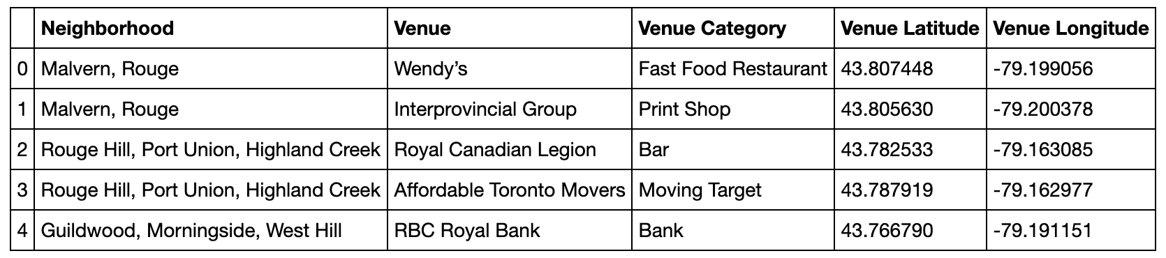
Exploring All Venues in Newcastle:

Slide 6
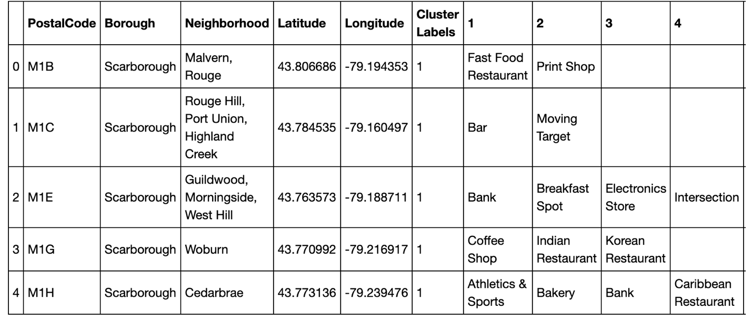
Clustering the Neighborhoods in Newcastle

Slide 7
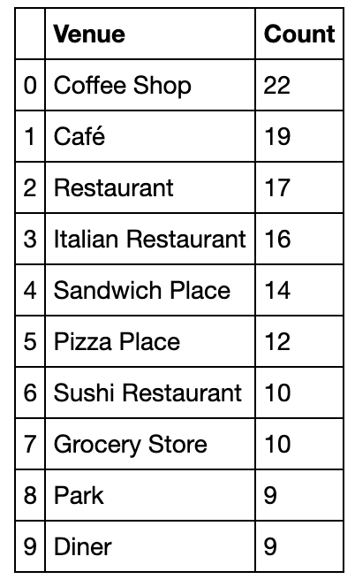
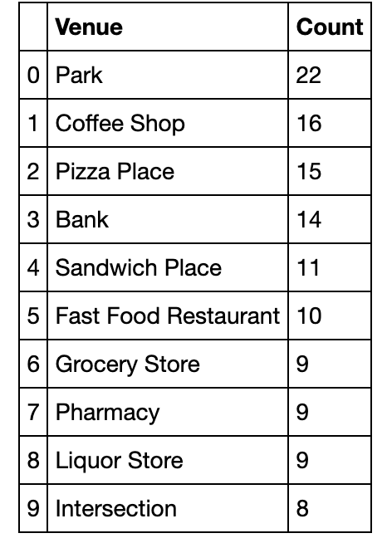
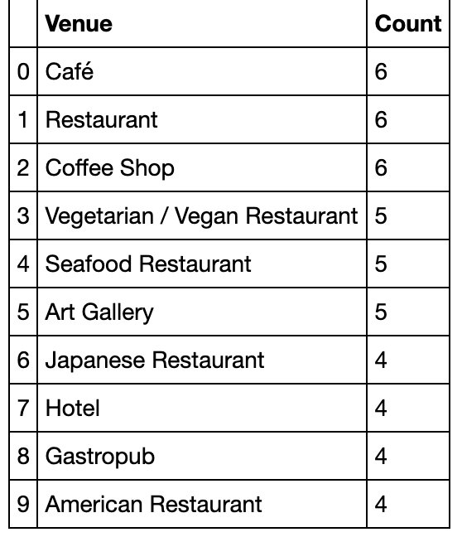
Analyzing Clusters:

